Slide 1

ICC Cricket Rankings: Data Analysis Project
A comprehensive overview of web scraping, data cleaning, analysis, and visualization of ICC cricket player rankings.

Slide 2
Project Steps
Agenda
Importing Libraries
Data Extraction (Web Scraping)
Setting up the essential tools for the project.
Gathering raw data from Cricbuzz.
Data Cleaning and Merging
Data Analysis and Visualization
Preparing and combining the scraped data.
Uncovering insights and presenting findings.

Slide 3
Importing Essential Libraries
The project begins by importing key Python libraries for web scraping and data manipulation.
requests
BeautifulSoup (bs)
pandas
Used to make HTTP requests to the Cricbuzz website to retrieve HTML content.
Parses HTML/XML documents, navigating structures to find specific data points.
Indispensable for data analysis, storing scraped data in DataFrames for cleaning and analysis.

Slide 4
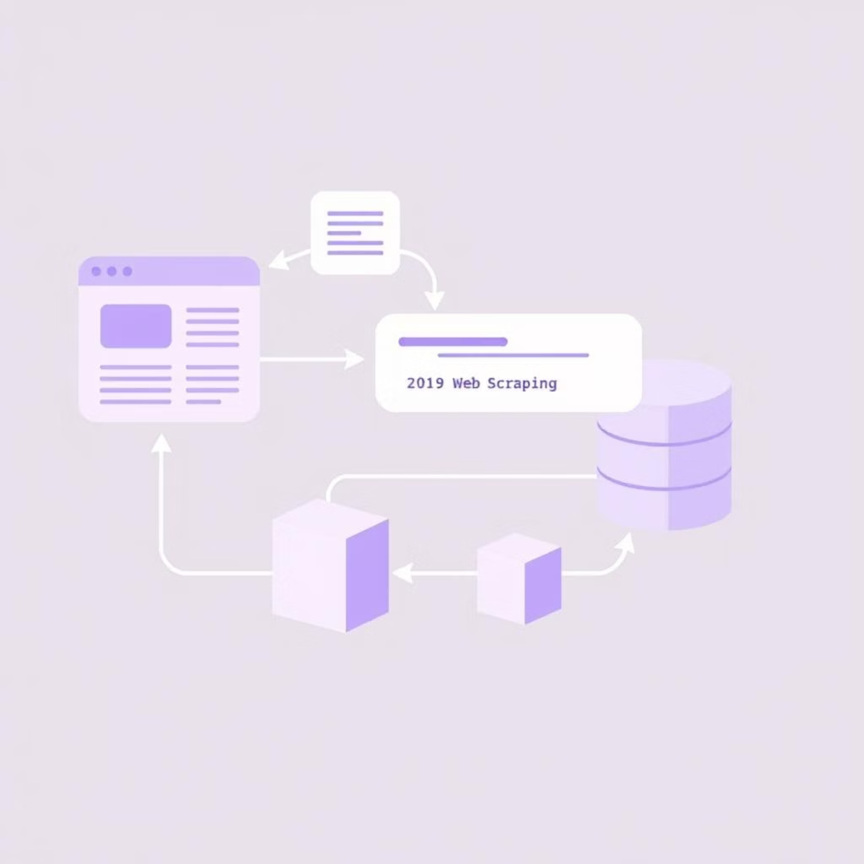
Data Extraction: Web Scraping
The core of the project involves scraping ICC rankings for men's batting, bowling, and all-rounders from Cricbuzz.
Target URLs
Men's Batting
Men's Bowling
Men's All-Rounder

Slide 5




Web Scraping Process
Make Request
Parse HTML
Fetch HTML content using requests.get().
Use BeautifulSoup to parse raw HTML text.
Find Data
Store & Convert
Locate player names, teams, ratings, and positions using CSS selectors.
Store in lists of dictionaries, then convert to pandas DataFrames for structure.

Slide 6
Data Cleaning and Merging
After extraction, data is cleaned and combined to create a comprehensive dataset.
Clean Player Names
Combine DataFrames
Remove extra whitespace using .str.strip().
Use pd.concat() to merge DataFrames for each player role.
Add Metadata
Convert Data Types
Include 'Role', 'Format', and 'Gender' columns for context and fill missing 'Gender' values.
Change 'Rating' and 'Position' to integers using .astype("int").

Slide 7
Data Analysis: Key Insights
Using pandas, we address key questions about the dataset's structure and player distribution.
Dataset Overview
Team & Country Analysis
Size and missing values (df.shape, df.isnull().sum()).
Top 5 teams with most players.
Distribution Analysis
Number of unique teams.
Players across formats (value_counts()).
Rating Analysis
Male vs. female players.
Basic statistics (mean, median, min, max).
Player count per role.
Range of ratings.

Slide 8



Cross-Category Analysis
Investigating relationships between player attributes and performing statistical tests.
Format & Gender Distribution
Rating Significance
Average Ratings
T-test to compare ratings between all-rounders and other players.
Analyze average ratings by Format, Role, and Gender using a pivot table.
Crosstabulation table: pd.crosstab(df['Format'], df['Gender']).

Slide 9
Data Visualization
Visualizing the data provides clear and comprehensive summaries of the ICC cricket player rankings.
Bar chart: Player distribution across formats.
Histogram with KDE: Rating distribution by gender.
Bar chart: Top 5 teams with most players.
Boxplot: Rating distribution, showing outliers.
Pie chart: Player distribution by role.
Heatmap: Correlation between Position and Rating.

Slide 10

Project Summary
This project successfully demonstrates a complete data workflow from web scraping and data cleaning to in-depth analysis and visualization, providing a clear and comprehensive summary of the ICC cricket player rankings.

